Slide 1



Bad
Bunny
Analysis of
SICSS-IAS
June 22, 2023
Mario Morales
Regan Smock
Bea Treena Macasaet
Gong Zhang

Slide 2
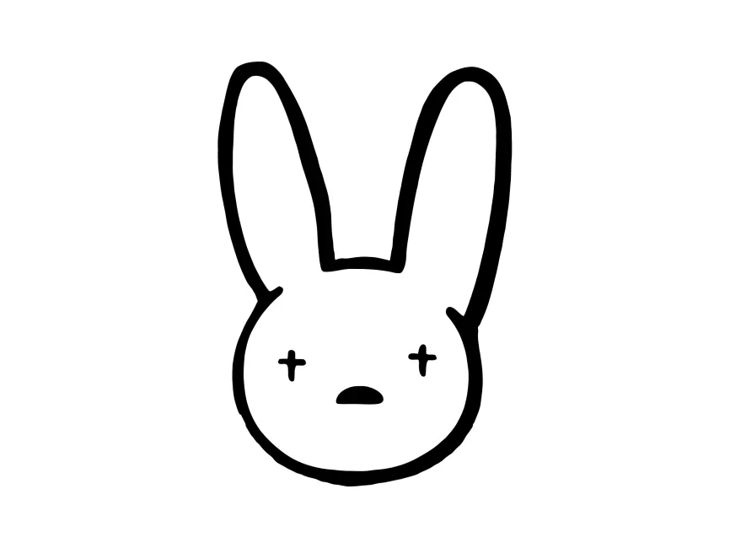
Who is Bad Bunny?
The most streamed artist on Spotify for the last three consecutive years and the highest grossing artist in the US in 2022.¹
He has won numerous awards, including three Grammys, three Latin Grammy, and the Spotify and Apple singer of the year.^{1,2}
Some claim that the “superstar phenomenon” accounts for Bad Bunny’s success, others claim that users do not recognize or appreciate "quality" or "ability" in singing.^{3,4}

Slide 3
Methods
Spatial analysis. Using Google trends data to examine spatial distribution of Bad Bunny’s popularity by country.
Textual analysis: Using Google Music Lyrics and Spotify data to uncover the underlying themes and emotions in Bad Bunny’s.lyrics.
Network analysis: Using Spotify data to examine the similarity and connections of Bad Bunny to other artists.

Slide 4
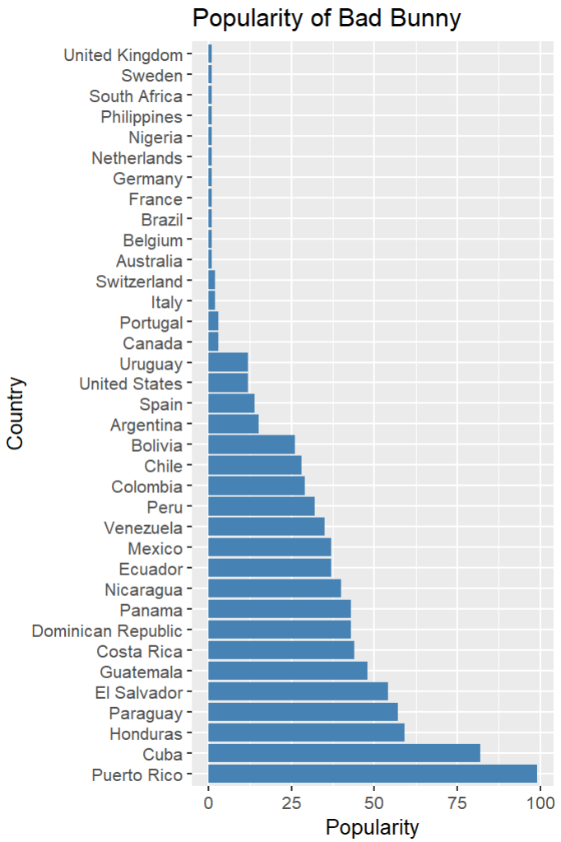
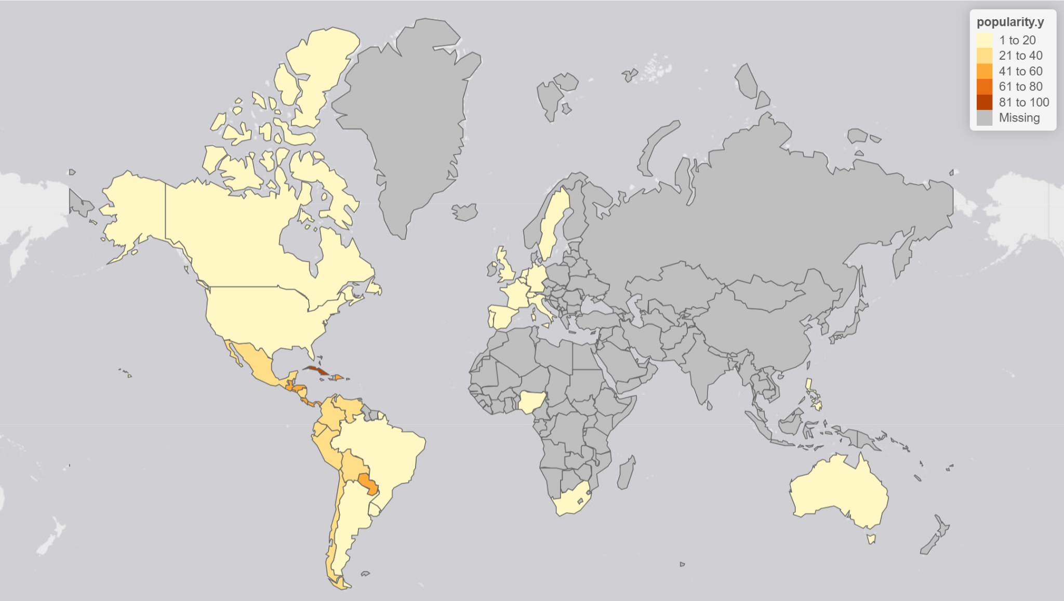
Spatial Analysis
Spatial distribution of Bad Bunny’s Popularity by country
Popularity by region (from Google Trends)
See in which location your term was most popular during the specified time frame. Values are calculated on a scale from 0 to 100, where 100 is the location with the most popularity as a fraction of total searches in that location. A higher value means a higher proportion of all queries, not a higher absolute query count. So a tiny country where 80% of the queries are for 'bananas' will get twice the score of a giant country where only 40% of the queries are for 'bananas'.

Slide 5
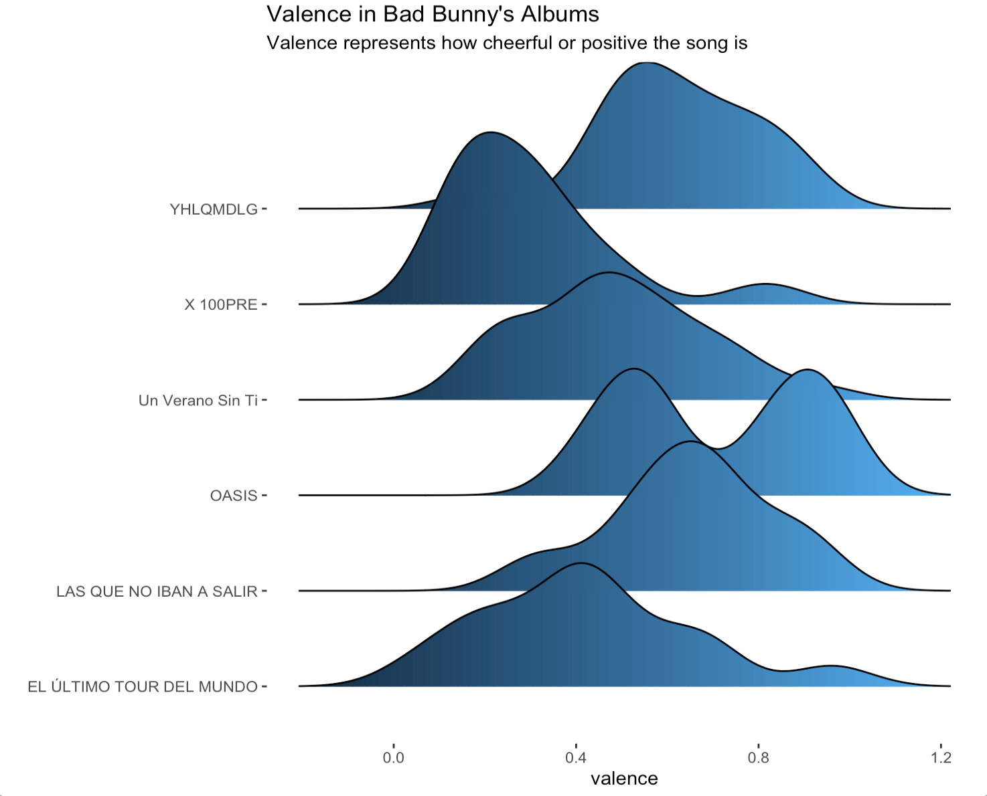
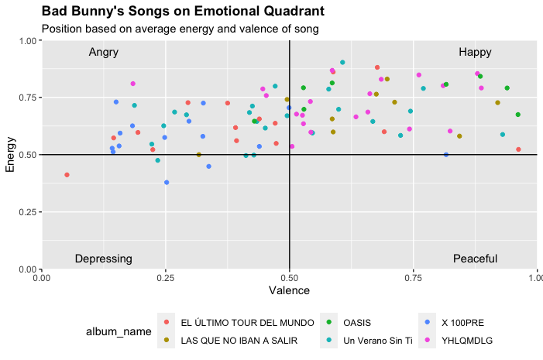
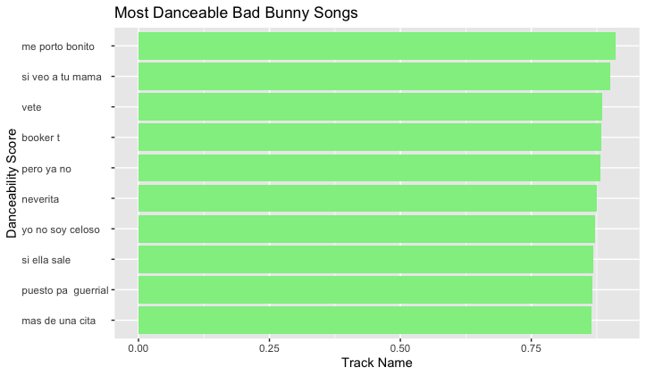
API Data Retrieval
Sound Feature Data

Slide 6
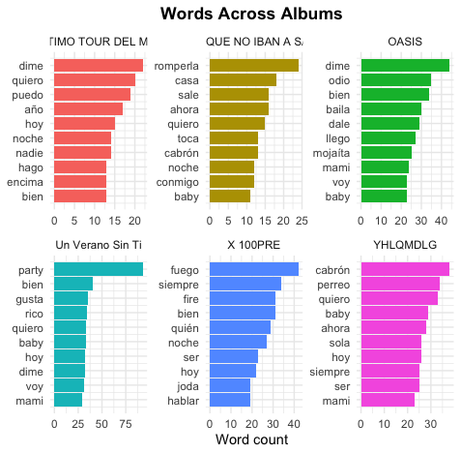
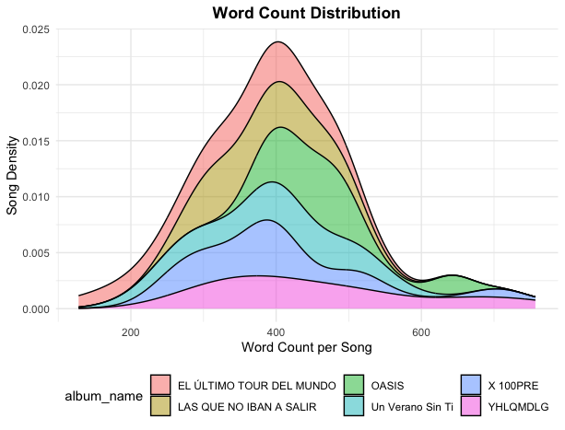
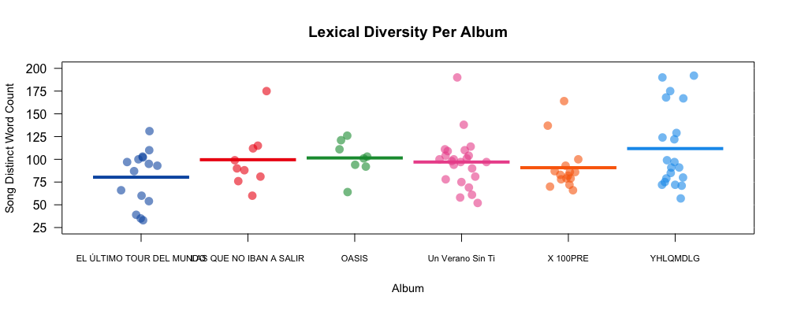
Textual Analysis
Descriptive Analysis of Lyrics

Slide 7
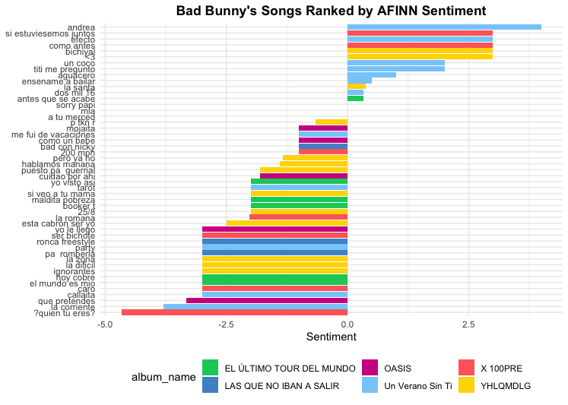
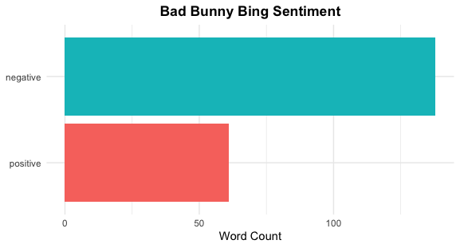
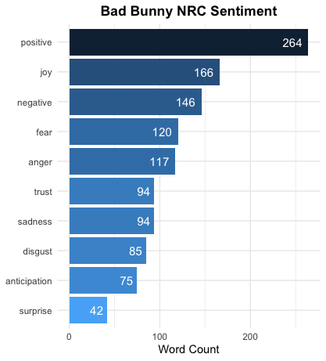
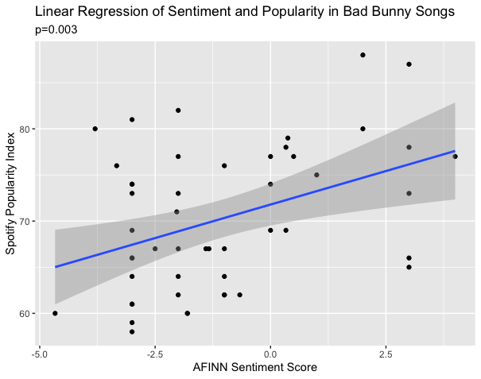
Textual Analysis
Sentiment Analysis

Slide 8
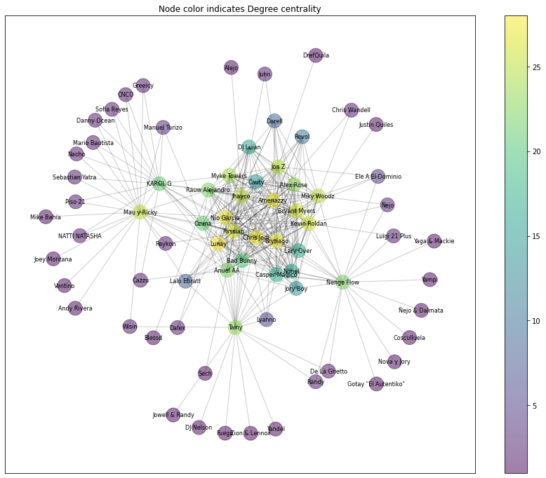
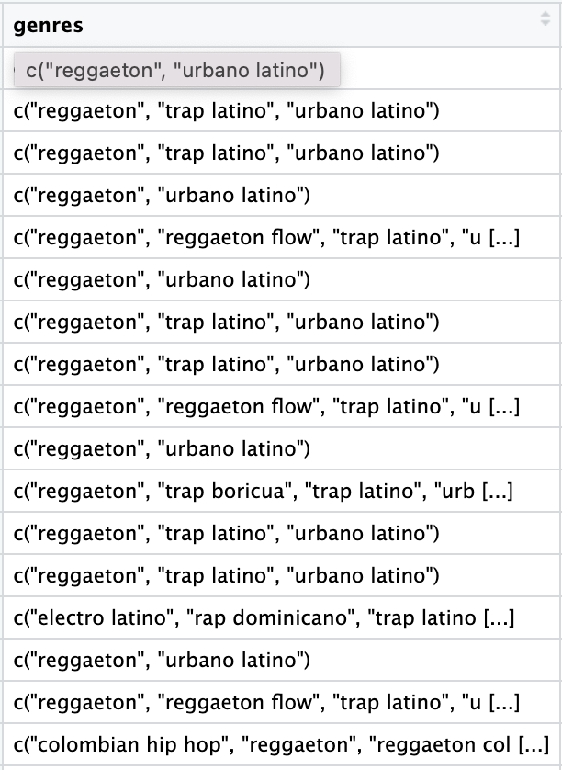
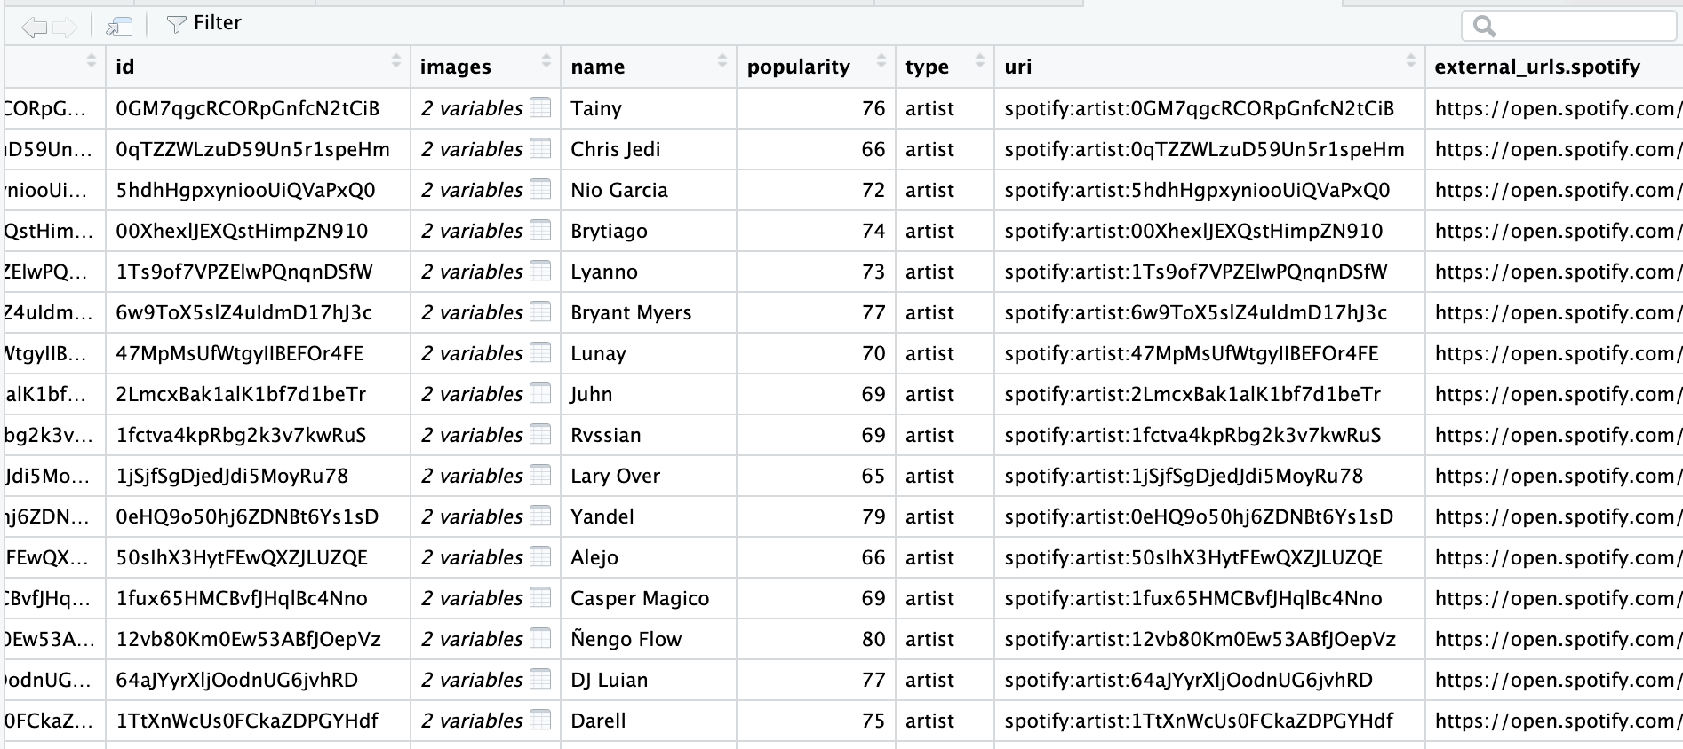
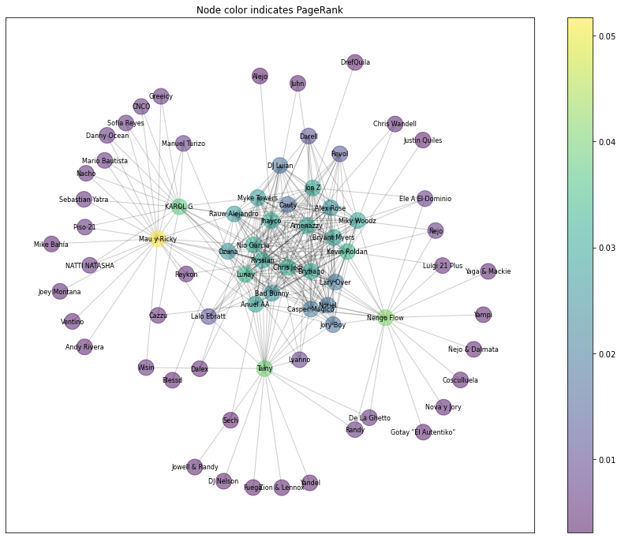
Bad Bunny’s similarity circle
Network of artists similar by one or two degrees to Bad Bunny:
72 unique artists
352 edges
Undirected, connected graph
Data preparation: Spotify data on similarity: 2 degrees
First level: 20 artists related to Bad Bunny
Second level: 20 Artists related to each of the 20 artists

Slide 9
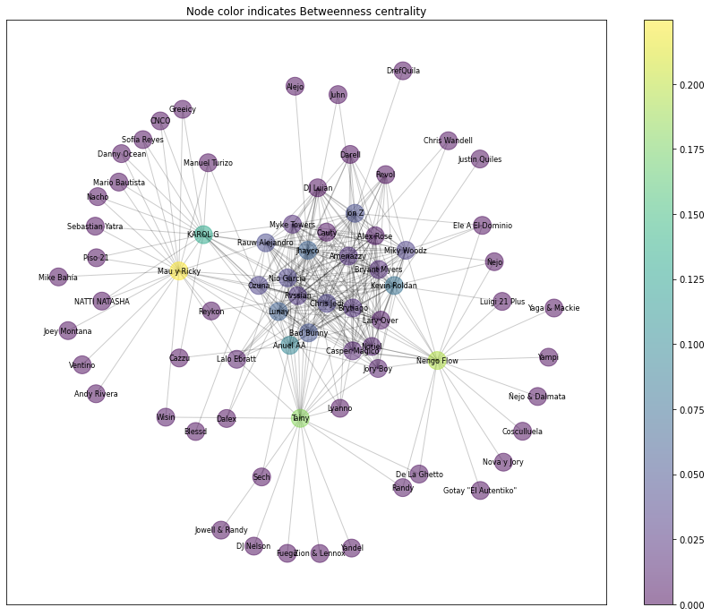
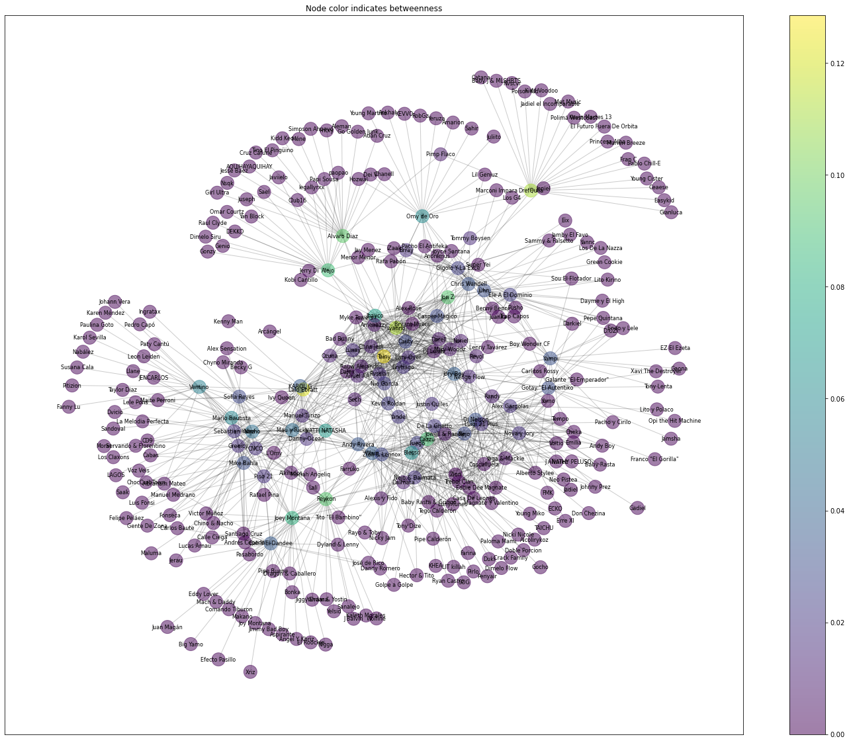
Bad Bunny’s similarity circle
What if we add another degree of similar artists?
What if we remove the bridges?
Two degrees
Three degrees

Slide 10
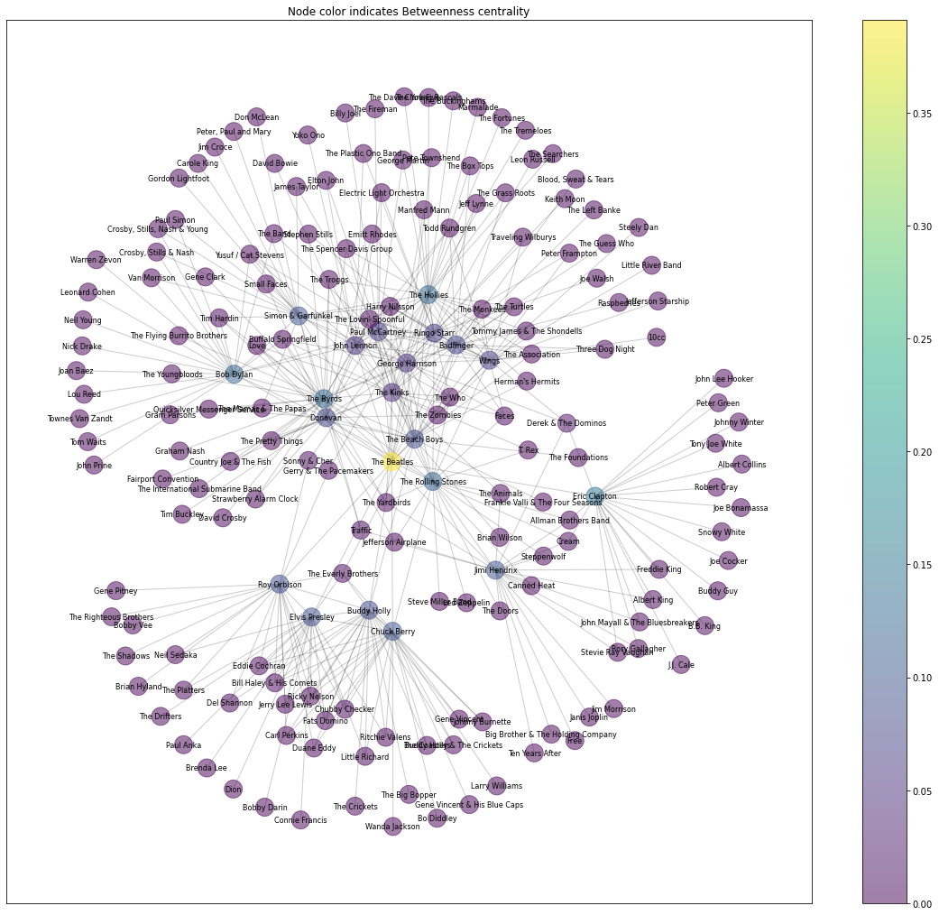
Bad Bunny’s similarity circle
Betweenness centrality
Just for fun…

Slide 11
Conclusions
Spatial analysis: Centered in Puerto Rico and radiating outward, he has a wide influence in Latin American countries, where people speaks mainly Spanish, like Cuba, Honduras, Paraguay, EI Salvador, Guatemala, Mexico, Peru, etc.
Textual analysis: Key descriptive insights about Bad Bunny’s sound features and lyrics showcase the music’s style. Sentiment analysis of lyrics examines the meaning of the words used in songs, with positive sentiment having a significant relationship with the popularity of songs.
Network analysis: Bad Bunny does not seem to bridge groups of artists in his similarity network.

Slide 12


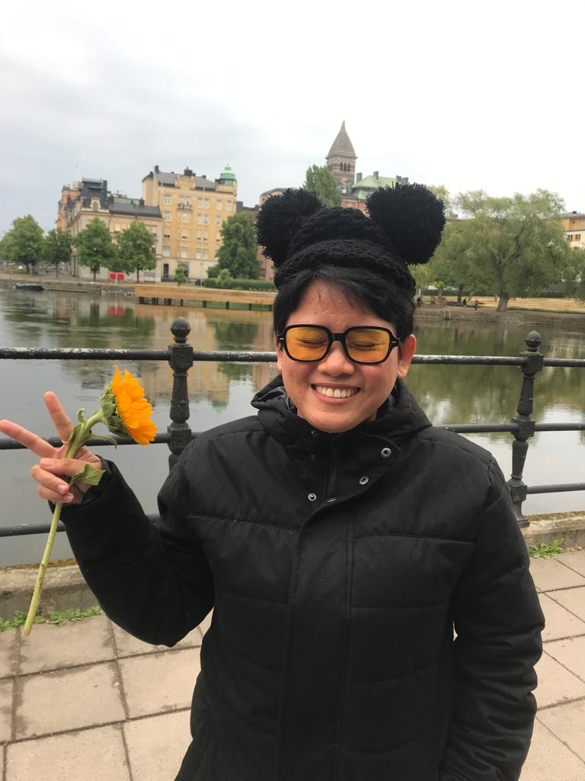

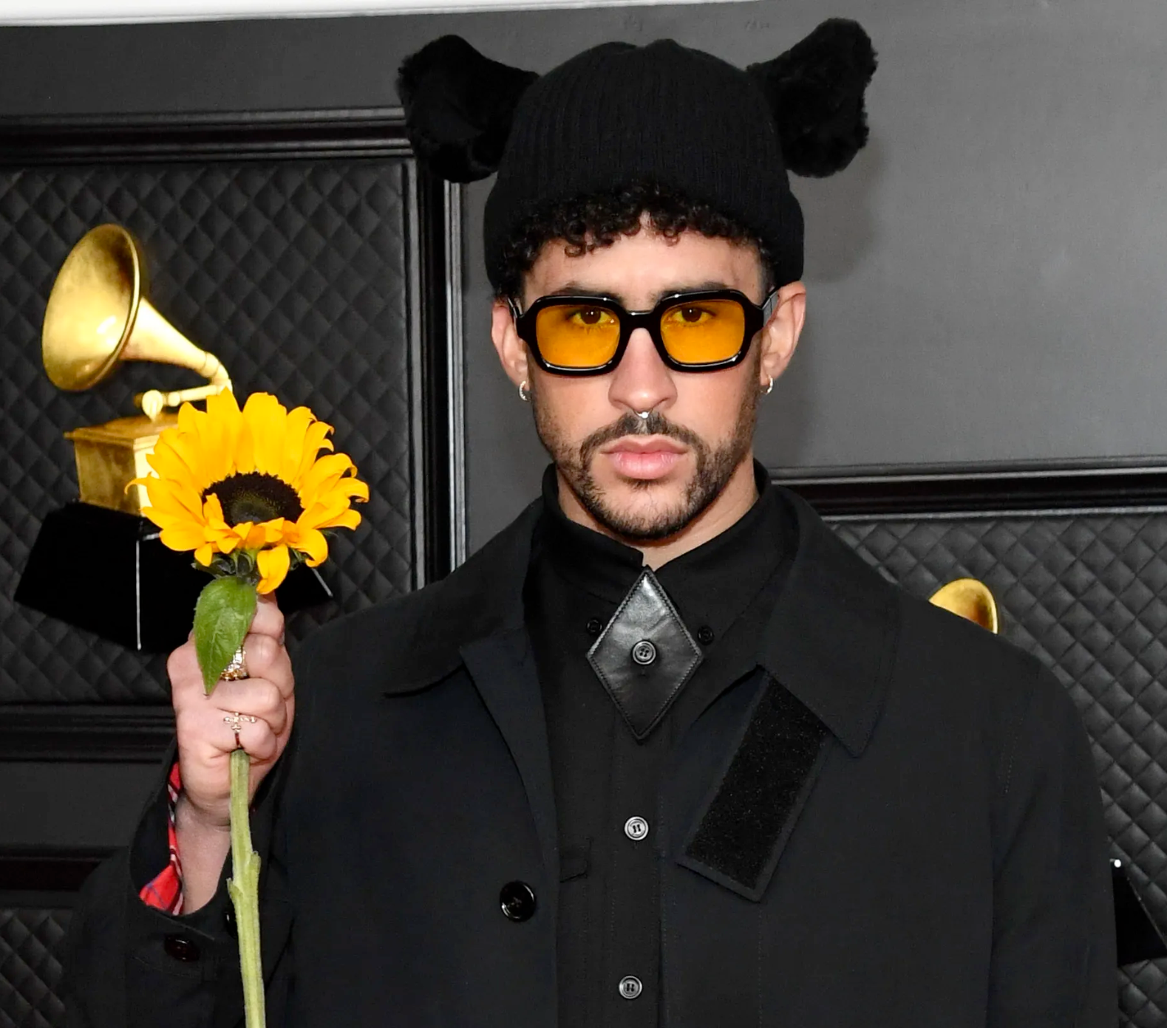
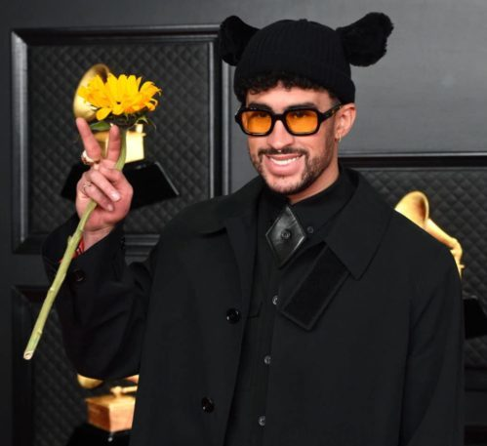
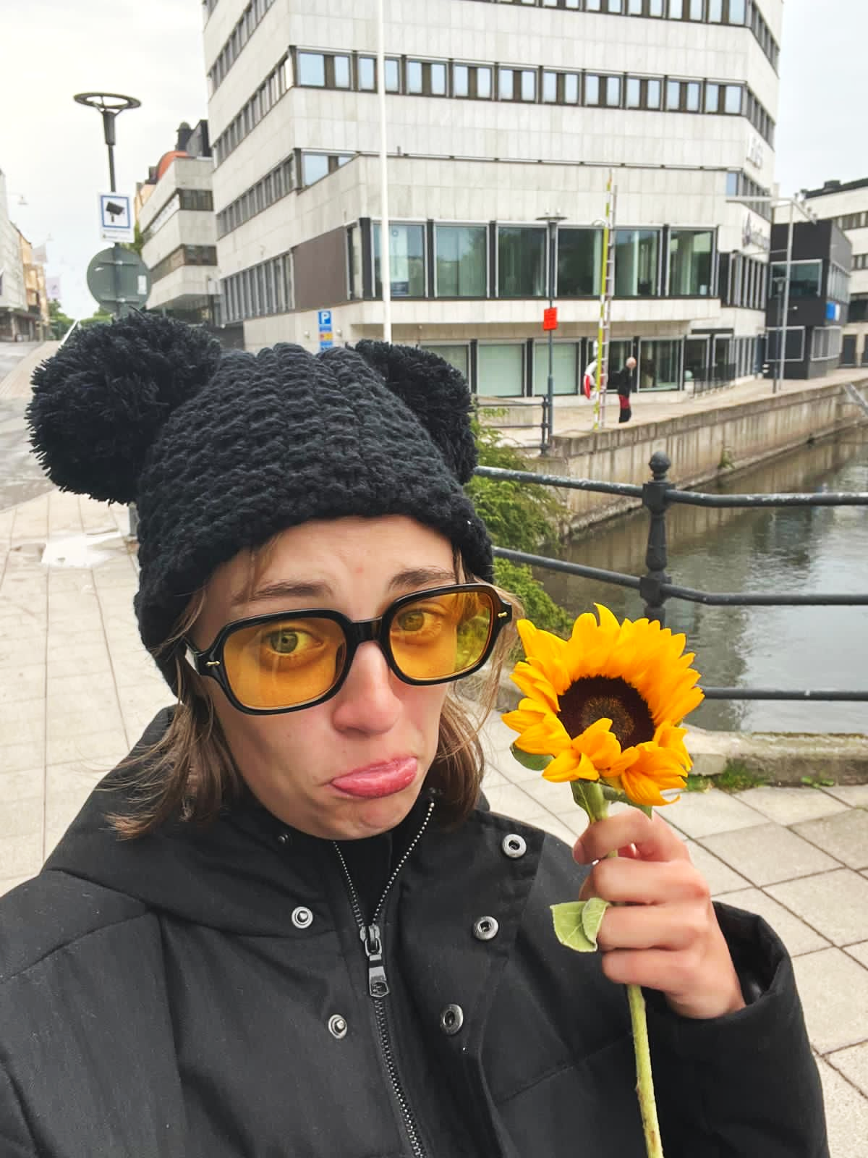
THANKS SICSS-IAS FOR MAKING OUR DREAMS COME TRUE!

Slide 13
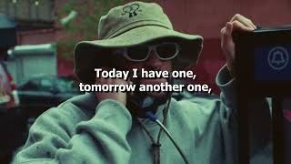
A sample of Bad Bunny: Tití Me Preguntó

Slide 14
Bibliography
Flores, G. Bad Bunny’s History-Making Accomplishments: A Timeline. Billboard. http://bit.ly/3wof6VM.
Beaumont-Thomas, B. How Did Bad Bunny Become the World’s Biggest Pop Star? The Guardian. https://bit.ly/3Ft0fxe.
Interiano, M.; Kazemi, K.; Wang, L.; Yang, J.; Yu, Z.; Komarova, N. L. Musical Trends and Predictability of Success in Contemporary Songs in and out of the Top Charts. R. Soc. Open Sci. 2018, 5 (5). https://doi.org/10.1098/rsos.171274.
Askin, N.; Mauskapf, M. Cultural Attributes and Their Influence on Consumption Patterns in Popular Music. In Social Informatics. 6th International Conference, SocInfo; Aiello, L. M., McFarland, D., Eds.; Springer: Barcelona, Spain, 2014; pp 508–530. https://doi.org/10.1007/978-3-319-13734-6.
Way, S. F.; Garcia-Gathright, J.; Cramer, H. Local Trends in Global Music Streaming. Proc. 14th Int. AAAI Conf. Web Soc. Media, ICWSM 2020 2020, No. Icwsm, 705–714. https://doi.org/10.1609/icwsm.v14i1.7336.
Bello, P.; Garcia, D. Cultural Divergence in Popular Music: The Increasing Diversity of Music Consumption on Spotify across Countries. Humanit. Soc. Sci. Commun. 2021, 8 (1). https://doi.org/10.1057/s41599-021-00855-1.

Slide 15
Extras

Slide 16
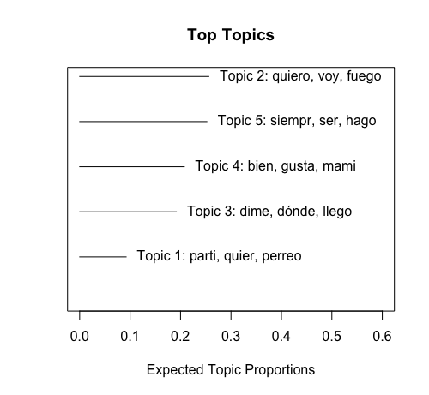
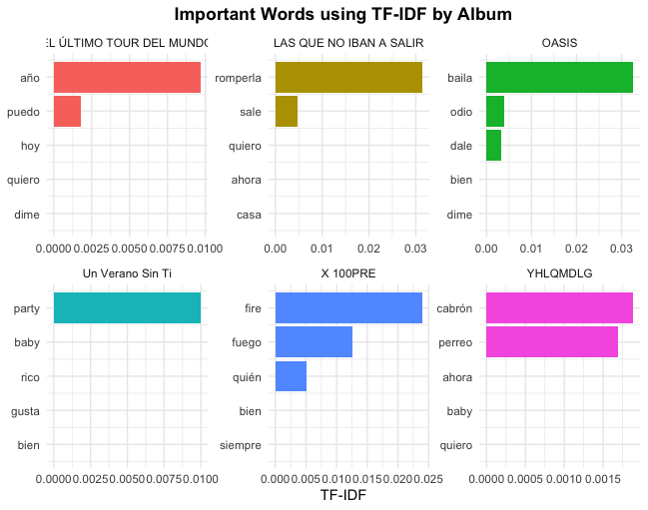
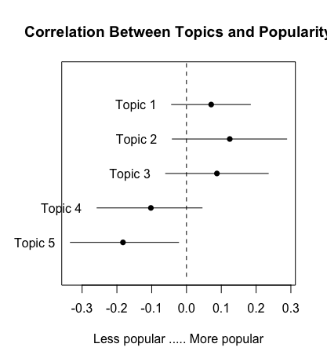
Textual Analysis
TF-IDF and Topic Modeling

